Slide 1
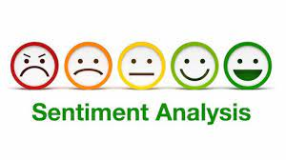
TWITTER SENTIMENT ANALYSIS USING Long-Short Term Memory (LSTM)

Slide 2
TEAM MEMBERS KOTA RAMA SAI VAMSI HARIRAM S PARIMI SUNAYANA
Guide
Ms. G. KOTHAI Ganesan

Slide 3
CONTENTS
Introduction
Abstract
Literature survey
Proposed System architecture
Proposed methodology
Tools and Data set
Results
Conclusion
Future scope
References

Slide 4
Abstract
The goal of tweet sentiment analysis is to find the positive, negative, or neutral sentiment part in the tweeter data.
Sentiment analysis can help any organization to find people's opinions of their company and products.
Twitter is a platform widely used by people to express their opinions and display sentiments on different occasions.
Sentiment analysis is an approach to analyze data and retrieve sentiment that it embodies.

Slide 5
INTRODUCTION
Sentiment analysis gets importance in these days. Every business organization now a days are very interested in knowing their customers emotion or sentiment towards their product or services.
There are several ways are there to do sentiment analysis.
Lexicon based and rule based methods gets outdated because of the arrival of the machine learning methodologies.
Now machine learning methods in turn gets older because of neural networks.
We promote a model based on Long Short Term Memory (LSTM)
LSTM is better in analyzing long sentence emotions effectively. LSTM is capable of learning long term capabilities

Slide 6
LITERATUE SURVAY
NO | YEAR | TITLE | OBJECTIVE | METHOD USED | ADVANTAGES | DISADVANTAGES
1. | 2018 | Twitter Sentiment Analysis via Bi-sense Emoji Embedding and Attention-based LSTM | Task of sentiment analysis and achieve the state-of-the-art performance | 1.Bi-sense Emoji Embedding 2. Attention-based LSTM | 1.Robust 2.Effectively represents Complex semantic, sentiment information | 1.Can’t tackle tasks involving multi-sense embedding
2. | 2018 | Advanced Combined LSTM-CNN Model for Twitter Sentiment Analysis | Effectively use lstm-mcnn and achieve the state-of-the-art performance | 1. LSTM-MCNN based on LSTM-CNN | 1.Makes use of encoder-decoder framework 2.Features learning in CNN are more intrinsic and effective | 1.Accuracy is only 76% and need more training
3. | 2019 | Evaluation of Deep Learning Techniques in Sentiment Analysis from Twitter Data | Evaluate different deep neural network configurations | 1.Multiple CNN-LSTM networks | 1. Multiple CNN and LSTM networks increases the performance of the system | 1. CNN and LSTM networks are combined together they perform better than when used alone
4. | 2021 | LSTM Based Sentiment Analysis | Model proposes sentiment classifiers that aids in the classification of emotion in text sequences | 1. Long Short Term Memory | 1.Brands are able to work faster, with more accuracy, toward more useful ends. | 1.It gives more accuracy, but features are very few.
5. | 2019 | US Airlines Sentiment Analysis using LSTM | Sentiment analysis with small amount of tweets of two classes positive and negative | 1. RNN language model based on Long Short Term Memory (LSTM) | 1.With small amount it is very effective and gives more accuracy | 1.It cant handle large data. 2.It gives only two classes

Slide 7
6. | 2021 | Sentiment Analysis of Nepali COVID19 Tweets Using NB, SVM and LSTM | Detecting sentiments in user opinions centered on a whole phrase and a specific entity | 1.NB 2.SVM and 3.LSTM | 1. Bernoulli’s NB performs best on aspect-based classification 2. LSTM Classifier performs best on entire sentences | 1.Model gives less accuracy for small data. 2.Requires more data for higher accuracy
7. | 2019 | Sentiment Analysis on Product Reviews Using Machine Learning Techniques | Sentimental analysis on product reviews using NB-SVM | 1.Dictionary-based approach under lexicon-based 2. NB and SVM | 1. NB got98.17%, SVM got 93.54% accuracy for Camera reviews. | 1.We cant predict exactly people liked or disliked.
8 | 2013 | Sentiment Analysis Tool using Machine Learning Algorithms | Model proposes sentiment classifiers of emotion in twitter data | 1. Naive Bayes, maximum entropy classification | 1.High accuracy for classifying sentiment when using this method | 1. Twitter messages have unique characteristics, accuracy is less.
9. | 2017 | Study of Twitter Sentiment Analysis using Machine Learning Algorithms on Python | Analyzing the sentiments of the tweets and feeding the data to a machine learning model | 1. Machine learning model-data collection, pre-processing, sentiment detection, classification, training and testing | 1.Works efficiently and models reaching the efficiency of almost 85%-90% | 1. lacks the dimension of diversity in the data 2. lot of application issues with the slang used and the short forms of words
10. | 2014 | Twitter Sentiment Analysis | Design of a sentiment analysis, classify customers’ perspective via tweets into positive and negative | 1.ML model based on web application system. | 1.Machine-based learning approach which is more accurate 2.Natural language processing techniques used. | 1. Due to limitation of Django which can only work on Linux server or LAMP. Thus, it cannot be realized.

Slide 8
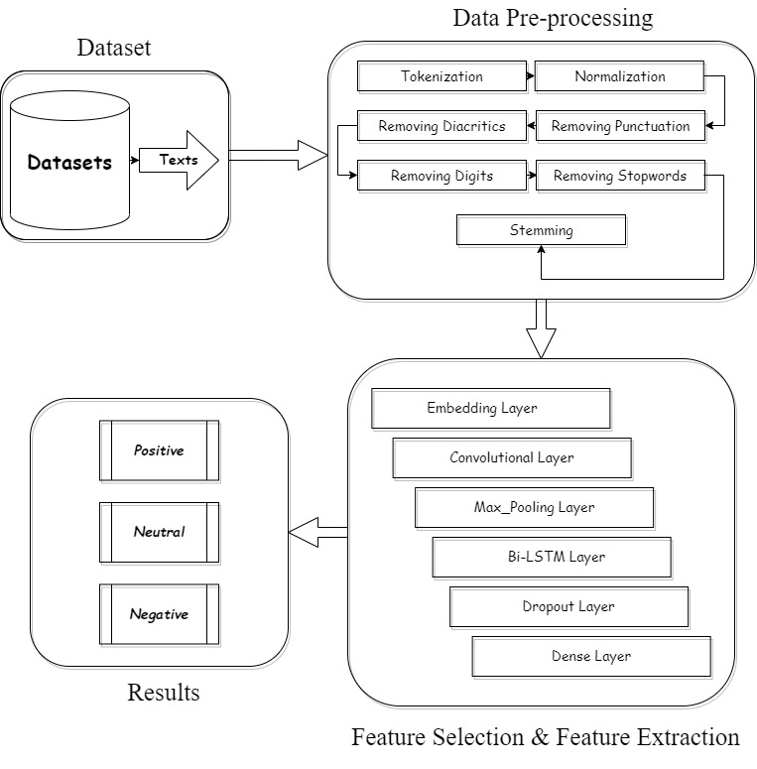
Proposed System architecture

Slide 9
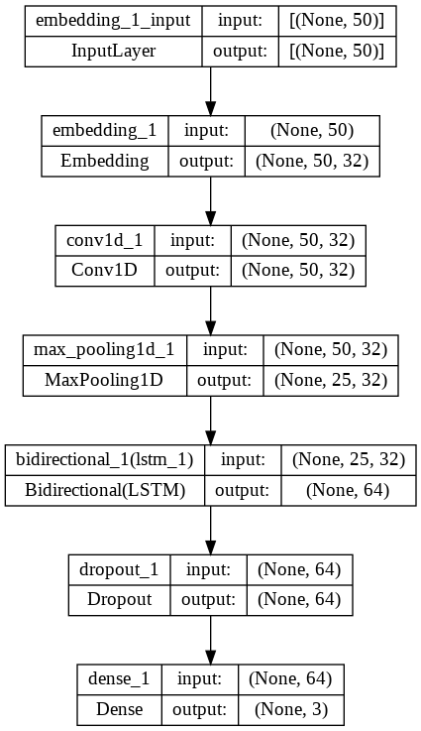
Proposed methodology
Our Methodology is to first pre-process the tweets in the data using the NLP methods. Initially with Tokenization, Normalization and by removing unwanted texts in the tweets.
Second we did feature selection and feature extraction with the layering of CNN-LSTM which is Bidirectional LSTM.
Embedding, Convolutional, Max_Pooling, Bi-LSTM, Dropout and Dense are the layers used.
Finally, we will predict that whether the text is Positive, Neutral or Negative.

Slide 10
TOOLS
Programming Language: Python
Platform: Google Colab
Packages:
NumPy
Pandas
Matplotlib
Seaborn
TensorFlow
NLTK
WordCloud
Sklearn
Keras
Pickle

Slide 11
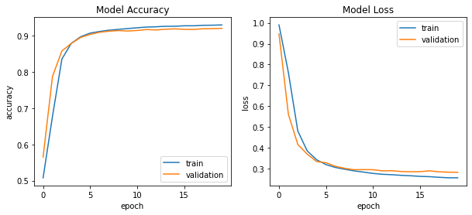
Results
We have got,
Accuracy of 91.41%
Precision of 91.71%
Recall of 91.05%
F1 Score of 91.38%

Slide 12
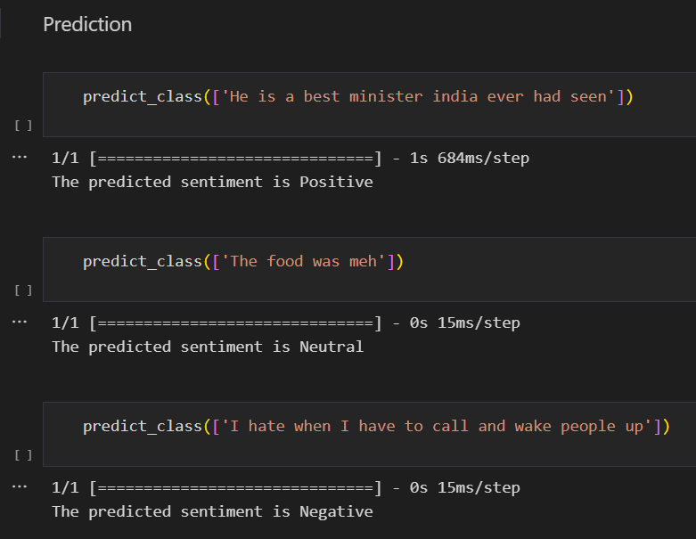
PREDICTION

Slide 13
Conclusion
In Conclusion, I would like to say that our model have performed well in Training and Testing.
The prediction of the sentence is also done and it gave the accurate results for the given sentence.
Since our model is performing in a good manner, we can provide our model for the company purposes and it can be used by them for the purpose of sentiment analysis of the customers.

Slide 14
References
[1] Sentiment Analysis Tool using Machine Learning Algorithms, 2013
[2] Twitter Sentiment Analysis, 2014
[3] Study of Twitter Sentiment Analysis using Machine Learning Algorithms on Python, 2017
[4] Twitter Sentiment Analysis via Bi-sense Emoji Embedding and Attention-based LSTM, 2018
[5] Advanced Combined LSTM-CNN Model for Twitter Sentiment Analysis, 2018
[6] Evaluation of Deep Learning Techniques in Sentiment Analysis from Twitter Data, 2019
[7] US Airlines Sentiment Analysis using LSTM, 2019
[8] Sentiment Analysis on Product Reviews Using Machine Learning Techniques, 2019
[9] LSTM Based Sentiment Analysis, 2021
[10] Sentiment Analysis of Nepali COVID19 Tweets Using NB, SVM and LSTM, 2021

Slide 15
THANK YOU

